Slide 1
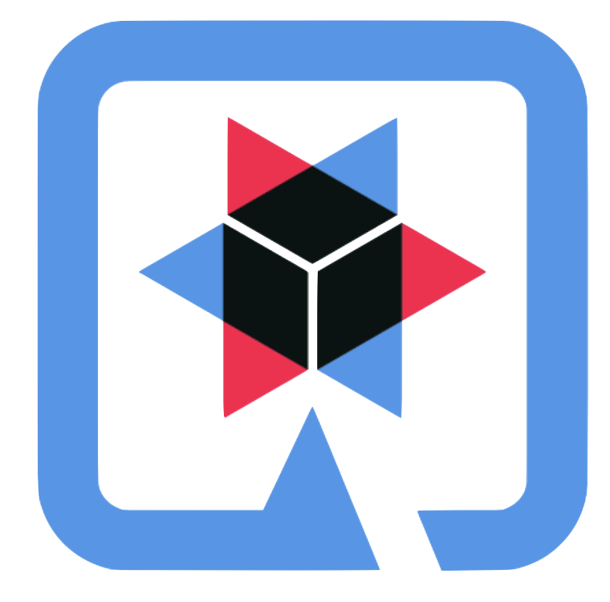
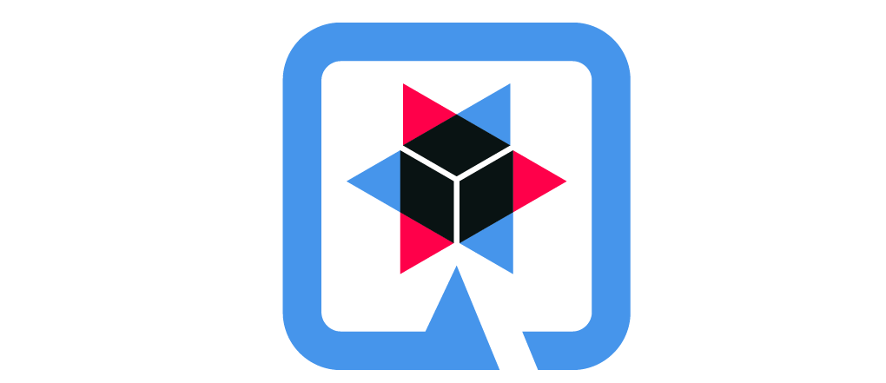
Developing with Quarkus: Supersonic Subatomic Java
Hands-On Workshop
Name
Title/Role
QUARKUS HANDS-ON LAB
Notes:
Traditionally, customers built monolithic apps, so the whole stack was optimized for running many apps on an app server
As we move toward additional/different cloud native microservices/serverless/event-driven apps, devs want to take advantage of this operational model
Not yet mainstream for enterpises, but the need is there from our large-scale customers

Slide 2

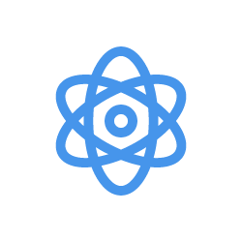
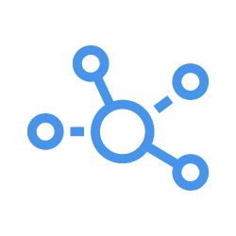
Growth in Application Architecture Choices
QUARKUS HANDS-ON LAB
Monolith
Cloud Native
Microservices
Serverless
Event-Driven Architecture
Notes:
Traditionally, customers built monolithic apps, so the whole stack was optimized for running many apps on an app server
As we move toward additional/different cloud native microservices/serverless/event-driven apps, devs want to take advantage of this operational model
Not yet mainstream for enterpises, but the need is there from our large-scale customers

Slide 3
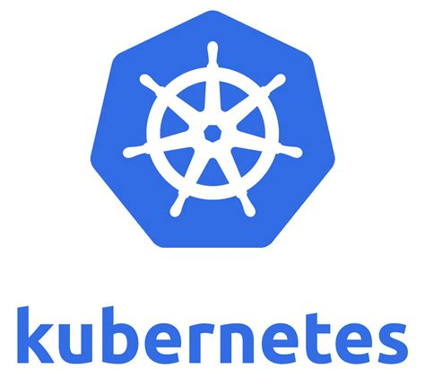

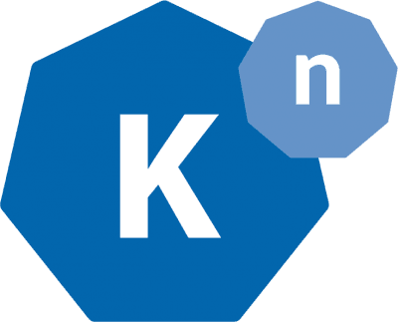
Common Deployment Platform
QUARKUS HANDS-ON LAB
Monolith
Cloud Native
Microservices
Serverless
Event-Driven Architecture
Istio
Knative
Notes:
One thing is common in these architectures - they’re increasingly being deployed to container-based operational environments like kubernetes
By sedimenting these concepts in the deployment platform, it’s a good step forward
So how do you do Java in this world?

Slide 4
Historical Enterprise Java Stack
QUARKUS HANDS-ON LAB
Architecture: Monoliths Deployment: multi-app, appserver
App Lifecycle: Months
Memory: 1GB+ RAM
Startup Time: 10s of sec
App
App
App
App
App
Dynamic Application Frameworks
Application Server
Java Virtual Machine (Hotspot)
Operating System + Hardware/VM
Notes:
Historical Java stack consisted of an application server running multiple applications. Red Hat has customers running over 100 applications on one JBoss EAP instance. Over most of the last 15-20 years, the Java application stack has been optimized to run large heaps and highly dynamic frameworks that make decisions at runtime.

Slide 5
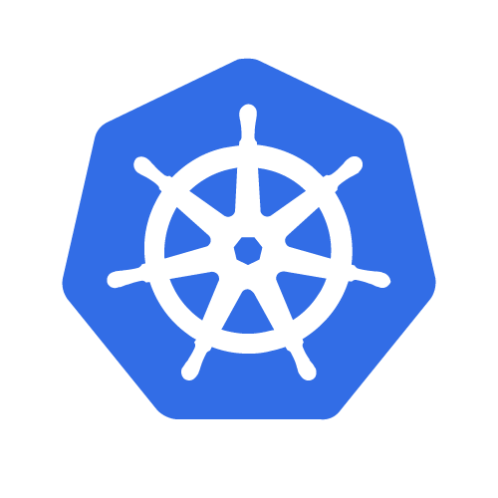
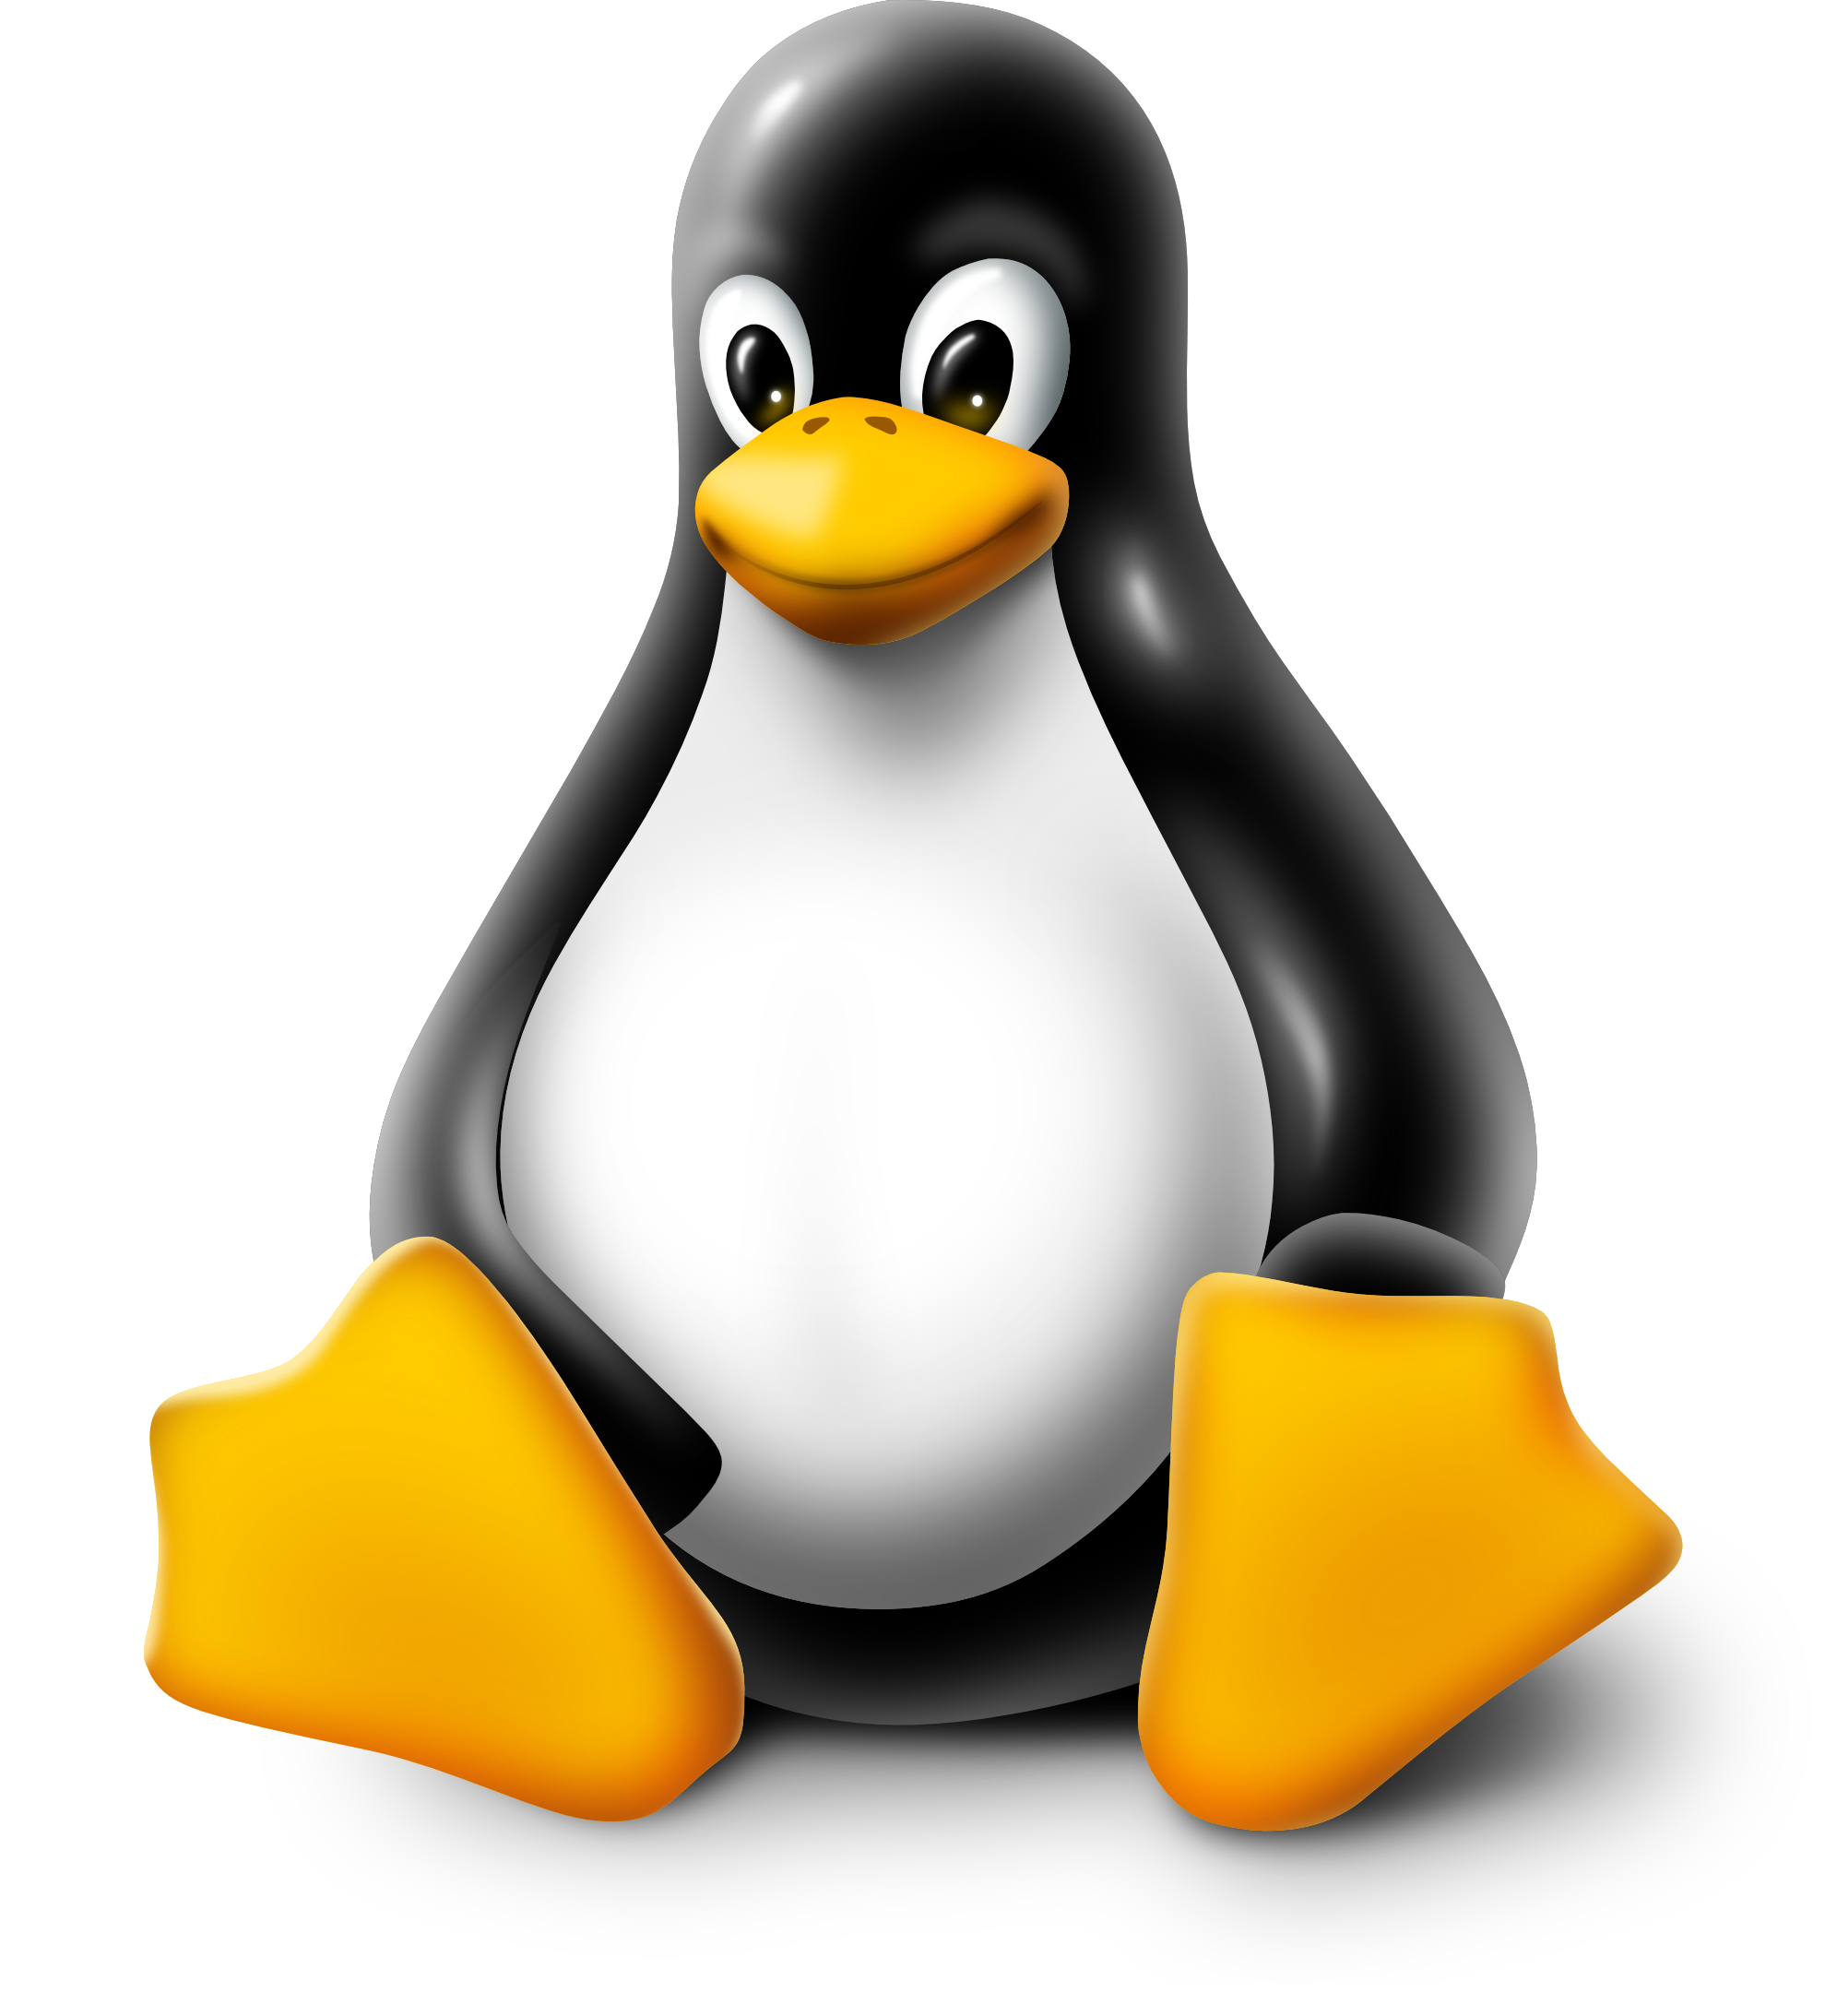
Modern Enterprise Java Stack
QUARKUS HANDS-ON LAB
Architecture: Microservices Deployment: Single App App Lifecycle: Days
Memory: 100MBs+ RAM
Startup Time: Seconds
App
Dynamic Application Frameworks
Application Server
Java Virtual Machine (Hotspot)
No Change
Notes:
The modern Enterprise Java stack hasn’t really changed much from the historical Java stack. Many of the same frameworks combined with some new ones, but still highly dynamic in nature. Overall not a lot of change. However, what has changed is the deployment environment, which is now Kubernetes. Kubernetes is all about immutable deployment infrastructure.

Slide 6
Java Serverless Stack
QUARKUS HANDS-ON LAB
Architecture: Microservices Deployment: Single App App Lifecycle: Days
Memory: 100MBs+ RAM
Startup Time: Seconds
App
Dynamic Application Frameworks
Application Server
Java Virtual Machine (Hotspot)
No Change

Slide 7
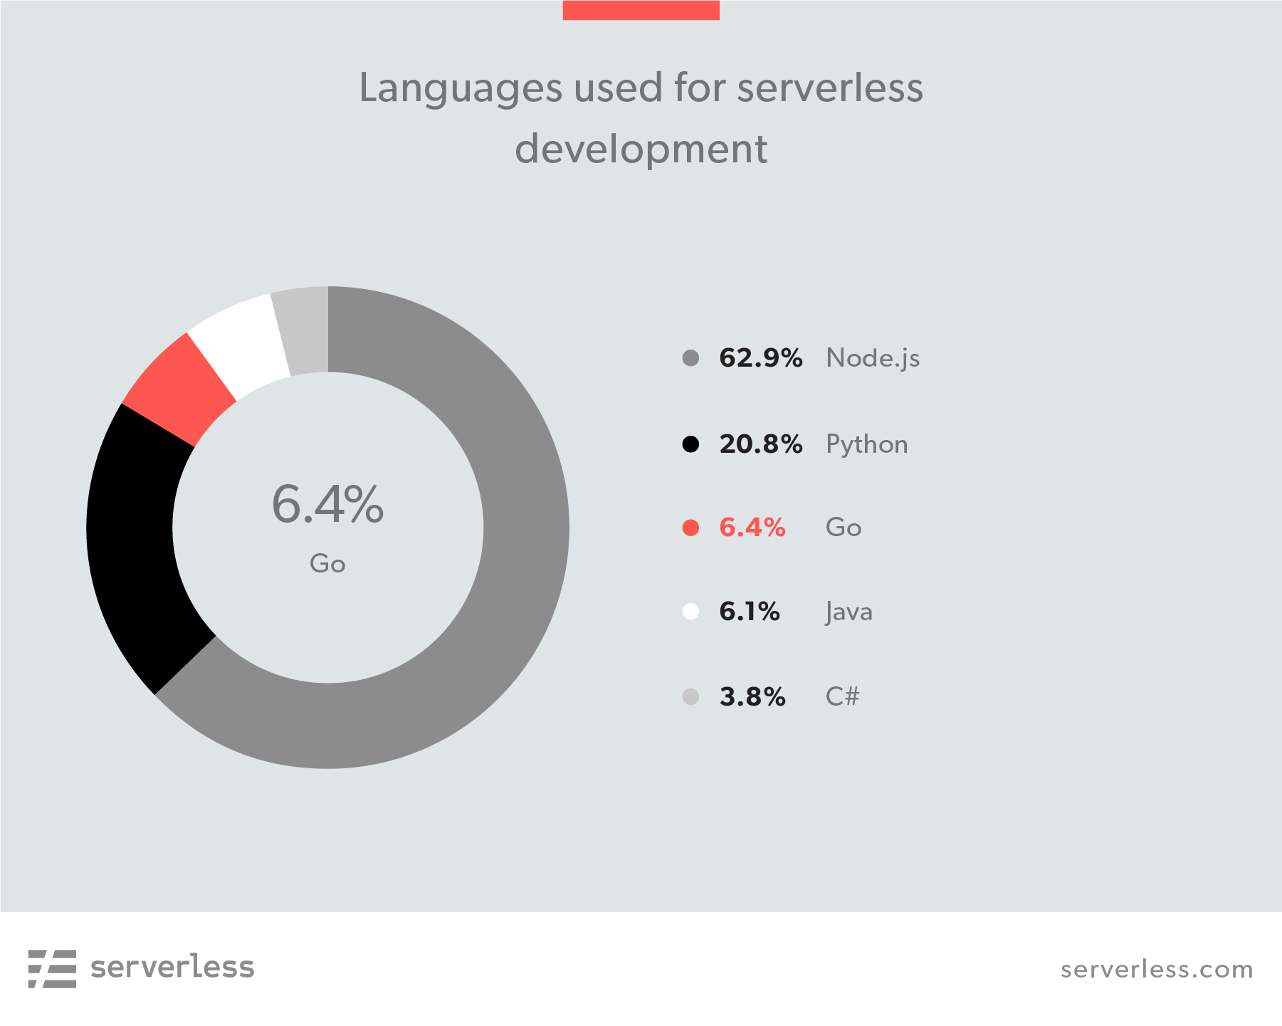
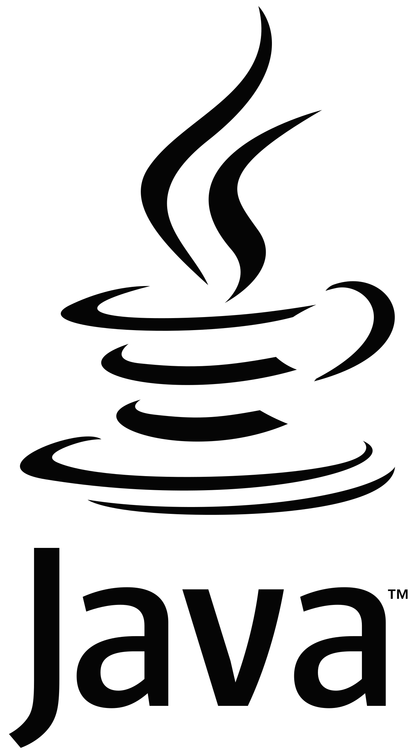
QUARKUS HANDS-ON LAB
https://serverless.com/blog/2018-serverless-community-survey-huge-growth-usage/

Slide 8
The Hidden Truth About Java + Containers
QUARKUS HANDS-ON LAB
Compute Node
Compute Node
Compute Node
HotSpot
NodeJS
Go
Go
Heap
NodeJS
Go
Go
HotSpot
Heap
NodeJS
Go
Go
NodeJS
Go
Go
HotSpot
Heap
NodeJS
Go
Go
NodeJS
Go
Go
HotSpot
Heap
NodeJS
Go
Go
Container platform
Notes:
Java was architected for running multiple apps in an app server
A lot of it is counter-productive in a highly dynamic env
So we see a lot of interest in Node.js (dev producivity) or Go (for pure efficiency) for containerized development, not so much for Java

Slide 9
Quarkus - Kubernetes Native Java
QUARKUS HANDS-ON LAB
Monolith
Cloud Native
Microservices
Serverless
Event-Driven Architecture
Istio
Knative
Notes:
Devs want to build microservices using these newer app architectures so that they run very efficiently in Kubernetes
So Quarkus was born to address this need
Quarkus does not target monoliths (grayed out). It’s really targeting microservices, serverless, event-driven architectures

Slide 10
Moving to Compile-Time Boot
QUARKUS HANDS-ON LAB
A dynamic runtime on immutable infrastructure is unnecessary overhead
What does a framework do at startup time
Framework Optimizations
Parse config files
Classpath & classes scanning
for annotations, getters or other metadata
Build framework metamodel objects
Prepare reflection and build proxies
Start and open IO, threads etc
Moved as much as possible to build phase
Minimized runtime dependencies
Maximize dead code elimination
Introduced clear metadata contracts
Spectrum of optimization levels (all → some → no runtime reflection)
Notes:
Traditional Java EE - the stack is optimized for a different environment (app servers) and there’s lots of work that happens at startup/runtime.
A dynamic runtime on immutable infrastructure is unnecessary overhead
So what if we take a lot of the heavy lifting and move it to build time?
Quarkus optimizes frameworks to make them more modular, reduce dependencies within the framework itself, and then in the build phase we boot the app, scan the classpath, strip out unneeded deps, and take that pre-created bytecode image and shove it back into the JAR file
So when you boot your app, it just loads all the pre-scanned, pre-canned point and executed quickly, e.g. 1 second boot times for a feature-rich app
This can be done for traditonal JDK apps (fat jars), but it can also take it another step and compile it down to a native binary with GraalVM

Slide 11
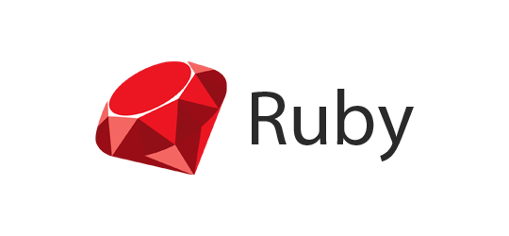


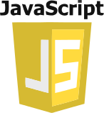
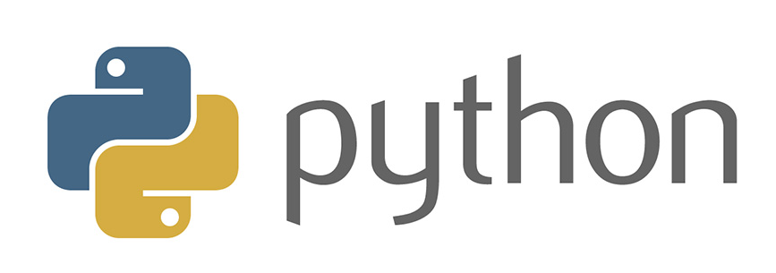
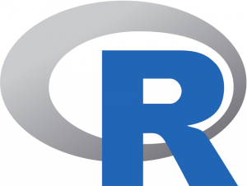
GraalVM
QUARKUS HANDS-ON LAB
Sulong (LLVM)
Truffle
Graal Compiler
JVM CI
Substrate VM
Java HotSpot VM
Notes:
Quarkus uses the red part of GraalVM that allows compilation down to native binary
The Graal Compiler does even more dead code elimination and puts the Substrate VM in the native binary to run the code at runtime

Slide 12
Quarkus Reduces Memory Utilization
QUARKUS HANDS-ON LAB
REST
Quarkus + GraalVM
13 MB
Quarkus + OpenJDK
74 MB
Traditional Cloud-Native Stack
140 MB
Notes:
1/10th the memory for Quarkus vs. traditional

Slide 13
Quarkus Reduces Memory Utilization
QUARKUS HANDS-ON LAB
REST + CRUD
Quarkus + GraalVM
35 MB
Quarkus + OpenJDK
130 MB
Traditional Cloud-Native Stack
218 MB
Notes:
Same kind of thing for CRUD apps - significant memory utilization

Slide 14
The New Truth about Java + Containers
QUARKUS HANDS-ON LAB
Compute Node
Compute Node
Compute Node
Compute Node
Traditional Cloud-Native Java Stack
NodeJS
Quarkus
Quarkus
Go
Go
Go
Quarkus
Quarkus
NodeJS
Quarkus
Quarkus
Go
Go
Go
Traditional Cloud-Native Java Stack
Quarkus
Quarkus
NodeJS
Quarkus
Quarkus
Go
Go
Go
Quarkus
Quarkus
NodeJS
Quarkus
Quarkus
Go
Go
Go
Traditional Cloud-Native Java Stack
Quarkus
Quarkus
NodeJS
Quarkus
Quarkus
Go
Go
Go
Quarkus
Quarkus
Traditional Cloud-Native Java Stack
NodeJS
Quarkus
Quarkus
Go
Go
Go
Quarkus
Quarkus
NodeJS
Quarkus
Quarkus
Go
Go
Go
Quarkus
Quarkus
CONTAINER ORCHESTRATION
Notes:
So you get outstanding density/efficiency from quarkus - close to Go, better than Node.js
So the “Java is too fat for cloud” no longer applies
It’s a game-changer

Slide 15
Quarkus Improve Startup Time
QUARKUS HANDS-ON LAB
REST
Quarkus + GraalVM 0.014 Seconds
Quarkus + OpenJDK 0.75 Seconds
Traditional Cloud-Native Stack 4.3 Seconds
REST + CRUD
Quarkus + GraalVM 0.055 Seconds
Quarkus + OpenJDK 2.5 Seconds
Traditional Cloud-Native Stack 9.5 Seconds
Notes:
Startup time - crazy fast.
So Quarkus becomes more relevant in Kubernetes/FaaS/serverless. Java is now a real player in that space now

Slide 16
Quarkus
QUARKUS HANDS-ON LAB
Architecture: Microservices, Serverless Deployment: Single App
App Lifecycle: Seconds to Days
Memory: 10MBs+ RAM
Startup Time: Milliseconds
App
Optimized Application Frameworks
Java Virtual Machine (Hotspot)
Optional

Slide 17
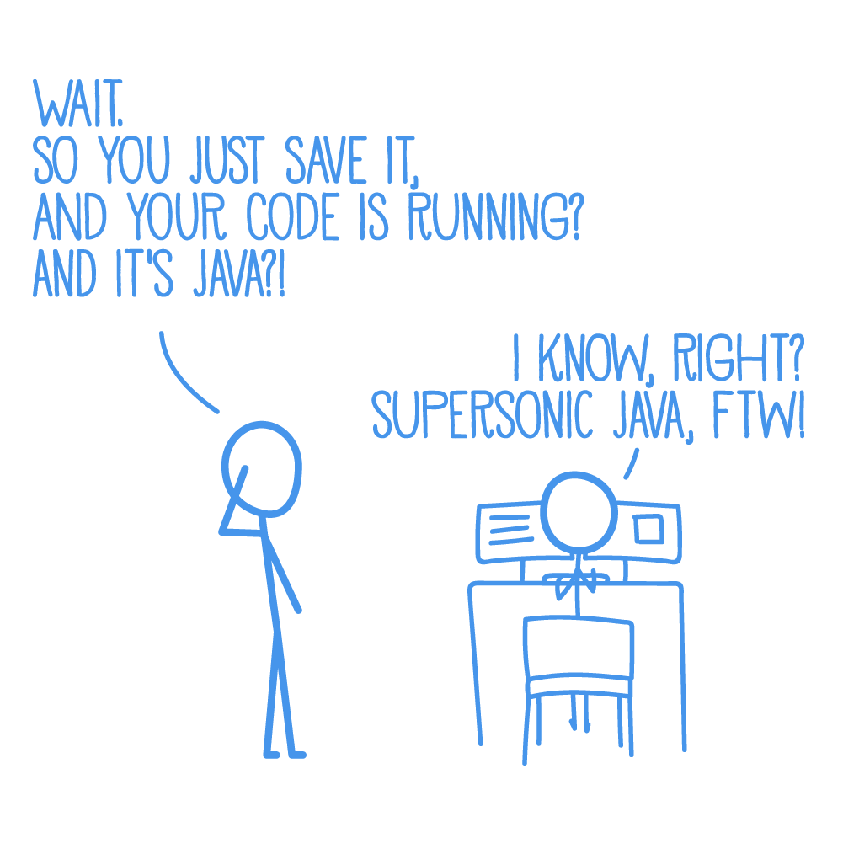
Developer Joy
QUARKUS HANDS-ON LAB
A cohesive platform for optimized developer joy:
Based on standards, but not limited
Unified configuration
Zero config, live reload in the blink of an eye
Streamlined code for the 80% common usages, flexible for the 20%
No hassle native executable generation
Notes:
Fast turnaround times (live reload) - so the dev/test/debug cycle (inner loop) becomes super fast, makes much more efficient developers
No JVM restarts, no agents, Quarkus recompiles on the fly. You can build an entire app by running the JVM once

Slide 18
Unifies Imperative and Reactive
QUARKUS HANDS-ON LAB
@Inject
SayService say;
@GET
@Produces(MediaType.TEXT_PLAIN)
public String hello() {
return say.hello();
}
@Inject @Stream(”kafka”)
Publisher<String> reactiveSay;
@GET
@Produces(MediaType.SERVER_SENT_EVENTS)
public Publisher<String> stream() {
return reactiveSay;
}
Combine both Reactive and imperative development in the same application
Inject the EventBus or the Vertx context
Use the technology that fits your use-case
Notes:
SO you can do Java EE style, or you can do vert.x/high async/reactive, all in the same runtime, at the same time even

Slide 19
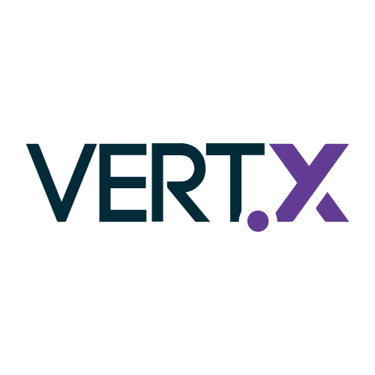

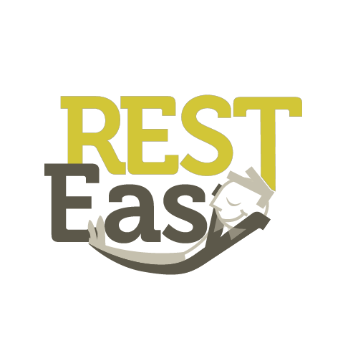


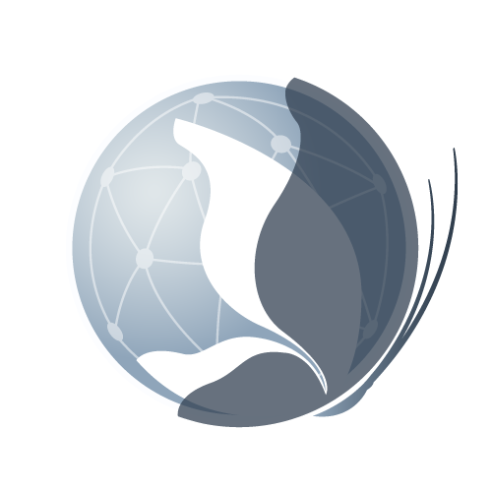
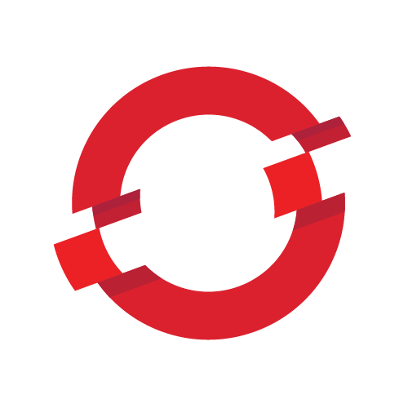
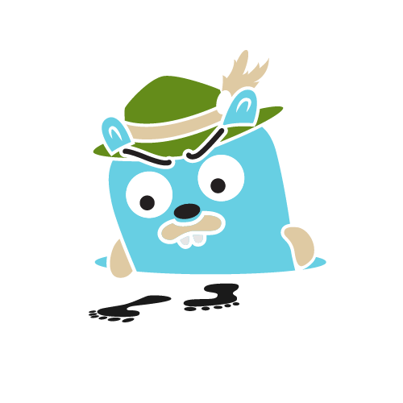

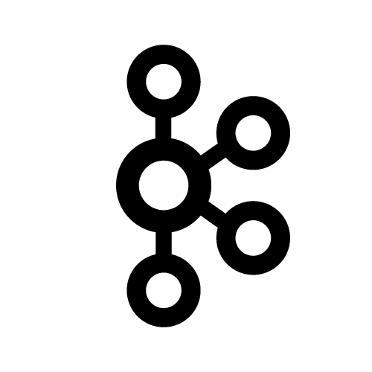

Best of Breed Frameworks and Standards
QUARKUS HANDS-ON LAB
Eclipse Vert.x
Hibernate
RESTEasy
Apache Camel
Eclipse MicroProfile
Netty
Kubernetes
OpenShift
Jaeger
Prometheus
Apache Kafka
Infinispan
Notes:
Lots of popular frameworks - not inventing our own. We’ve optimized ~50 frameworks and more both for JVM and Native mode. We’re starting to see community contributions as well (e.g. Vault access for secure passwords, swagger integration, and a handful more). It’s growing exactly as intended.

Slide 20
“Feels familiar and new at the same time”
QUARKUS HANDS-ON LAB
Notes:
Really cool comment from Twitter that shows we’ve hit the sweet spot - low barrier to entry, but lots of new capabilities they need. So to close, we’re making big investments in Java going forward.

Slide 21
Containerization
Introduction to Containers

Slide 22
TRADITIONAL OS VS. CONTAINERS
Traditional OS
Containers
CONTAINER
CONTAINER
APP A
APP B
APP A
APP B
HOST OS
LIBS A
LIBS B
LIBS C
LIBS D
LIBS A
LIBS B
LIBS C
LIBS D
HOST OS
INFRASTRUCTURE
INFRASTRUCTURE
Notes:
Full Stack software packaging concept that typically includes a Single Application and all of its runtime dependencies
Easy to deploy and portable across host systems, eliminating differences between different application life-cycle stage deployments
Isolates applications on a host operating system
Encourages Microservices

Slide 23
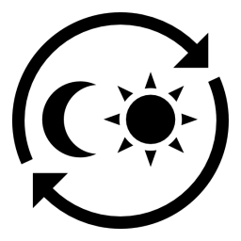
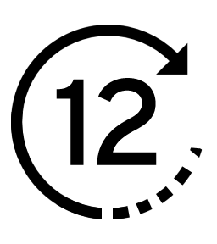




VELOCITY AND DENSITY
Time to set up
27 HRS
12 MINS
10 SECS
CONTAINER INSTANCE
PHYSICAL SERVER
VIRTUAL MACHINE
Density
10
100
VIRTUAL MACHINE
INSTANCES
CONTAINER INSTANCES

Slide 24
WE NEED MORE THAN JUST CONTAINERS
WE NEED ORCHESTRATION!!!
Scheduling Decide where to deploy containers
Security Control who can do what
Lifecycle and health Keep containers running despite failures
Scaling
Scale containers up and down
Discovery Find other containers on the network
Persistence
Survive data beyond container lifecycle
Monitoring Visibility into running containers
Aggregation
Compose apps from multiple containers
Notes:
Although building and running single containers on a host is fairly simple, build and running multi-container application across multiple infrastructure requires more than just containers.

Slide 25
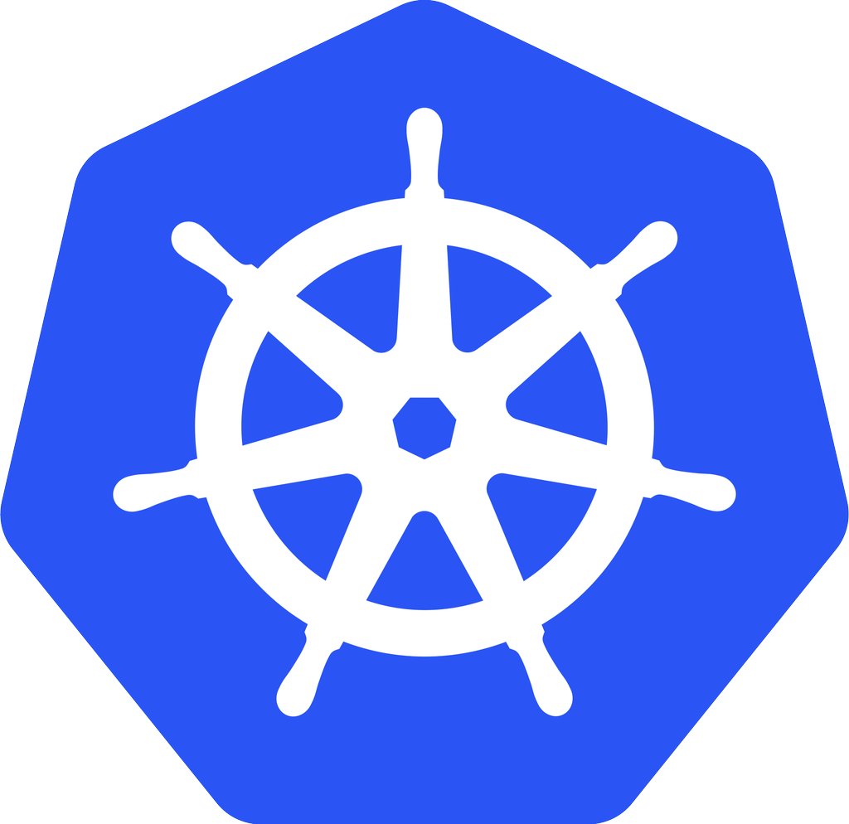
Kubernetes - open-source ORCHESTRATION framework
Developed by Google
Manages container lifecycle, health, scaling
Has its own Command Line Interface and API
Red Hat is THE top contributor to Kubernetes, after Google
kubernetes
Notes:
Kubernetes automates deployments of containers across the hosts
Kubernetes
open-source orchestration framework
developed by Google
manage the containers lifecycle, health, scaling, authentication, discovery and persistence.
15+ years of experience
Red Hat along with Google is the top contributor to the Kubernetes project.

Slide 26
BUT WAIT, THERE’S MORE!
Multi-tenancy
Teams and Collaboration
Routing & Load Balancing
Quota Management
CI/CD Pipelines
Image Build Automation
Role-based Authorization
Container Isolation
Capacity Management
Vulnerability Scanning
Infrastructure Visibility
Chargeback
Notes:
Even that still is not enough. There are more capabilities needed to successfully taking these containers to production.

Slide 27
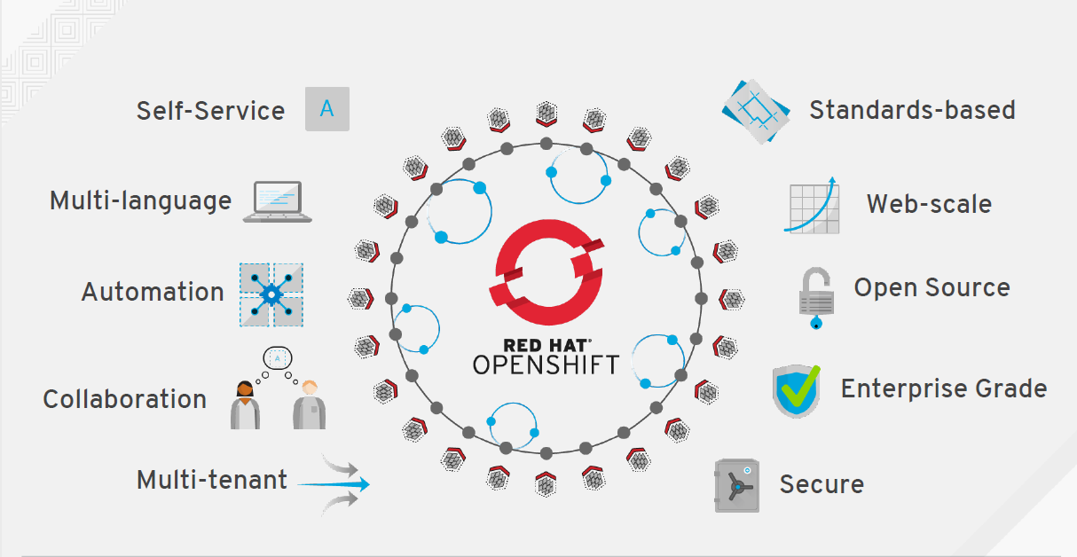
Why OpenShift

Slide 28
OpenShift
Product Deep Dive

Slide 29
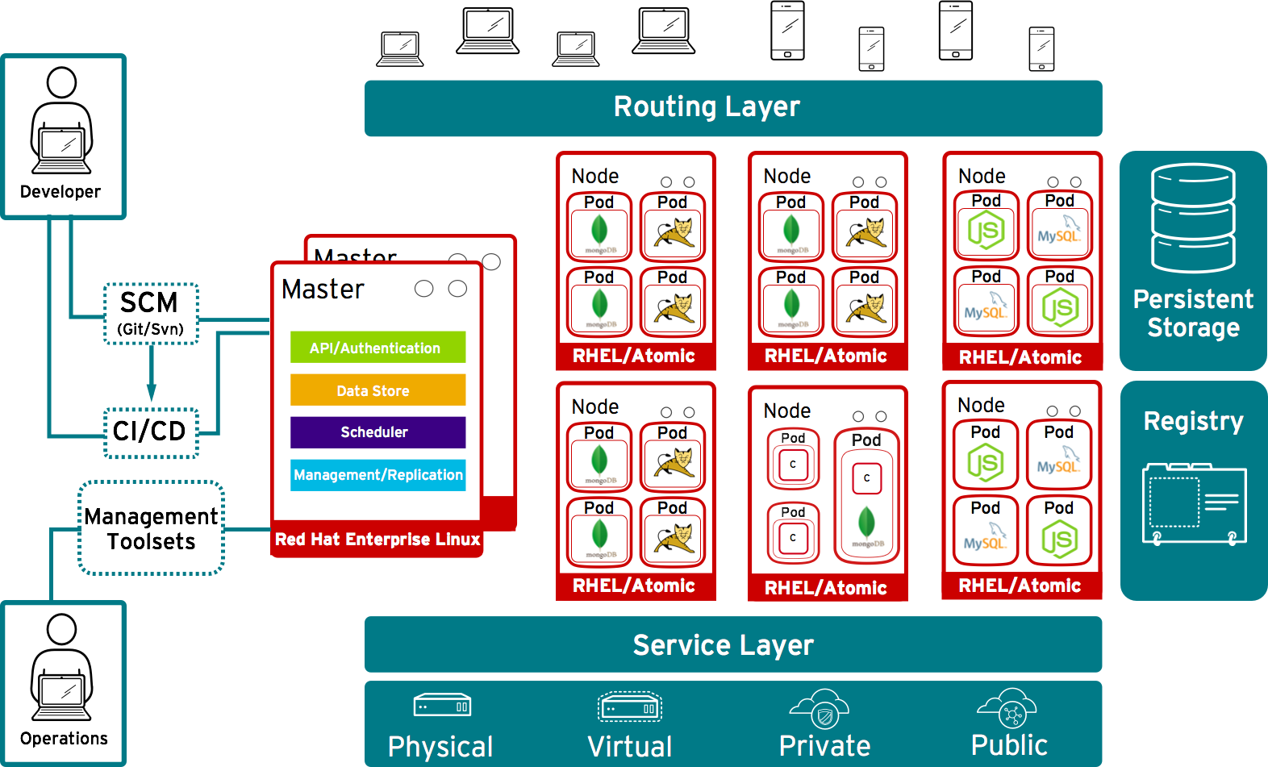


Developers access openShift via web, CLI or IDE
Notes:
Starting with the Infrastructure layer:
OpenShift is designed to run anywhere RHEL can run. It can be deployed to physical machines or virtual machines that live in the data center, or in private and public clouds.
This includes running on bare metal physical servers, on your choice of virtualization platform (including RHEV/KVM, vSphere, Hyper-V), private cloud platforms like OpenStack or certified public cloud providers like Amazon, Google and more.
With Openshift, you can also take a hybrid cloud approach and deploy instances of OpenShift Enterprise to both private and public clouds.
OpenShift is comprised of two main types of systems. The first we’ll cover are the Nodes.
Nodes are Linux container hosts where your applications will run and can be deployed on either RHEL 7 or on RHEL Atomic Host (may not be fully certified in 3.0).
RHEL 7 includes support for Linux containers in the Docker format
RHEL Atomic Host, which is derived from RHEL, is a secure, lightweight, and minimal footprint operating system optimized to run Linux containers.
Application services run in containers
Each node can run multiple application instances
What is an app on OpenShift?
Applications one or more set of pods, connected by services.
What makes up a Pod?
Docker Image - An executable image that represents a runnable component (web app, mysql, etc), a set of exposed ports, and an set of directories for persistent data.
Container - A running execution environment based on a Docker image and runtime parameters
Pod - A set of related containers that should always run and scale together on a host as a single atomic unit.
Pods can be comprised of just one container (typical) but they can also be comprised of multiple containers. Whether a pod contains a single container or multiple, OpenShift will treat it as a single unit. Typically, the only thing you would want to put together in a single pod are things that should scale and be replicated together. For instance, mysql and phpmyadmin.
What makes this unique to other PaaSs out there is that Docker is natively integrated. This means that anything that is a docker image will run as a docker container on OpenShift
The other major component of OpenShift is the Master.
Masters are essentially the superintendents. Their job is to orchestrate everything and know the state of everything.
Masters are installed on RHEL and can be architected to run across multiple RHEL instances so they are highly available.
Masters consist of the API’s, schedulers, controller's, and state storage systems necessary to run the OpenShift environment. We’ll go over each of these components in a minute
Masters leverage kubernetes
How an application is deployed on OpenShift
A high level API (kubcontrol api which is Oauth2 based) that allows end users and clients to offer an application centric view of the world, vs a container centric view.
API server validates and configures the data for pods, services, and replication controllers.
Performs project validation on incoming requests and invokes/triggers on other major system components.
Granular role based access
Web interfaces, CLI, and IDE’s will interface to that API
The Data Store is comprised of etcd and essentially a persistent key value store for various states of things in OpenShift
This is where information on users as well as apps deployed are stored.
etcd stores the persistent master state while other components watch etcd for changes to bring themselves into the desired state.
the controller manager server watches etcd for changes to replication controller objects and then uses the API to enforce the desired state.
The scheduler is what determines which of these nodes a pod will be deployed on
Request comes in through the master API and the scheduler determines what's the best node to run this application on.
This is a very intelligent and complex algorithm that takes in a bunch of different data points into account like CPU, port complex, etc. Once the node is decided the newly compiled image is pulled in from the registry and stood up on the node inside their pods
The service layer is responsible for connecting pods together across different nodes and handles things like networking and routing.
All of that connection information is handled by the Kubernetes service model. This service model consists of two main components a service label and a service proxy.
The service label is a common label you apply to each of the pods that make up that service.
The service proxy is a single IP address that other services can call and use to connect to individual instances within that service
When a Pod goes down, OpenShift realizes this immediately and automatically:
Starts to rebalance traffic across available Pods
Deploys a new pod to replace the old one and binds it to the service
Then rebalance traffic again across the newly created node
Pods are ephemeral which means that if they get restarted, anything that’s stored within the pod goes away. Obviously that isn’t ideal for pods that have databases
OpenShift Enterprise 3 gives you the ability to leverage mapped storage volumes for stateful services
OpenShift Enterprise 3 also has storage plugins that you can leverage for things like cloud storage (AWS, Google, etc.)
More storage backends are being implemented in the near future (gluster, ceph, ISCSI, etc.)
Conflicts are managed on the storage side.
The routing layer is how external requests get to your applications.
The routing layer is able to connect any of the pods on any of the nodes to any external traffic allowed through policy.
Leverages master and the data store for connection information.
Makes routing simpler than compared to v2 and enables more integration with external routing services like F5 or Nginx.

